Slide 1
Desquamative gingivitis
RUNGTA COLLEGE OF DENTAL SCIENCES AND RESEARCH,BHILAI
Dr pushpendra yadav
Sr. lecturer
Dept of Periodontology

Slide 2
SPECIFIC LEARNING OBJECTIVES
CORE AREAS | DOMAIN | CATEGORY
DEFINITION | Affective | Desire to know
HISTORY | Cognitive | Nice to know
CLASSIFICATION | Cognitive | Must to know
CLINICAL FEATURES | Cognitive | Must to know
MANAGEMENT | Cognitive | Must to know
CLINICAL EXAMINATION | Cognitive | Must to know
MICROSCOPIC EXAMINATION | Cognitive | Must to know
DISEASES THAT CAN MANIFEST AS DESQUAMATIVE GINGIVITIS | Cognitive | Must to know

Slide 3
CONTENT
PART-I
DEFINITION
HISTORY
CLASSIFICATION
CLINICAL FEATURES
MANAGEMENT
CLINICAL EXAMINATION
MICROSCOPIC EXAMINATION
PART -II
DISEASES THAT CAN MANIFEST AS DESQUAMATIVE GINGIVITIS
SUMMARY
REFERENCE

Slide 4
DEFINITION
Desquamative gingivitis is defined as an unusual, unique, non plaque associated gingivitis characterized by intense diffuse erythema and desquamation (peeling) of the surface epithelium. It is often associated with ulceration of the marginal and attached gingiva.
It is not a specific disease entity but a clinical manifestation of a variety of conditions.

Slide 5
HISTORY
Tomes and Tomes in1894
reported first
Goodby in 1923
mentioned in his book
Prinz in 1932.
Gave the term chronic diffuse desquamative gingivitis

Slide 6
Merrit and Sorin in 1933
published articles
Schour and Massler in 1947
gave the term “gingivosis” in anemic hospitalized children of post war Italy.
McCarthy and others in 1960 .
classic description and classification
followed by inputs from Glickman and Smulow and Ziskin and Zegareli.

Slide 7
CLASSIFICATION
Based on the etiological considerations desquamative gingival lesions are classified as under:
Dermatoses
Endocrinal imbalance
Chronic infections
Idiopathic
Drug reactions (lichenoid reactions)
Others (conditions which mimic desquamative gingivitis)

Slide 8
I. Dermatoses
1. Lichen planus
2. Benign mucous membrane phemphigoid
(cicatricial phemphigoid)
3. Bullous phemphigoid
4. Pemphigus vulgaris
5. Psoriasis
6. Linear immunoglobulin A disease
7. Dermatitis Herptiformis
8. Lupus Erythematosus
9. Erythema Multiformae

Slide 9
II. Endocrinal imbalance:
1. Estrogen deficiency in females (menopause,
following hysterectomy and oopharectomy)
2. Testosterone deficiency in males.

Slide 10
III. Chronic infections
1. Tuberculosis
2. Chronic candidiasis
3. Histoplasmosis

Slide 11
IV. Idiopathic
-Drug reactions (lichenoid reactions)
1. Toxic – antimetabolites
2. Allergic – barbiturates, antibiotics and certain
dental materials
-Others (conditions which mimic desquamative gingivitis)
1. Crohn’s disease
2. Chronic ulcerative stomatitis
3. Plasma cell gingivitis
4. Graft versus host disease
5. Factitious lesions
6. Kindler syndrome
7. Wegener’s granulomatosis
8. Foreign body gingivitis.

Slide 12
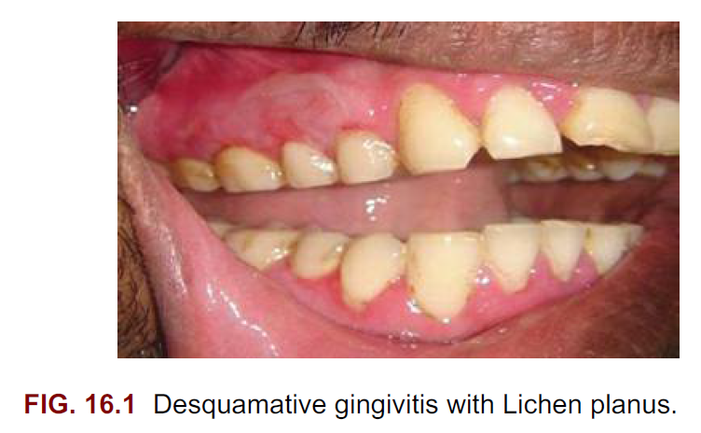

Slide 13
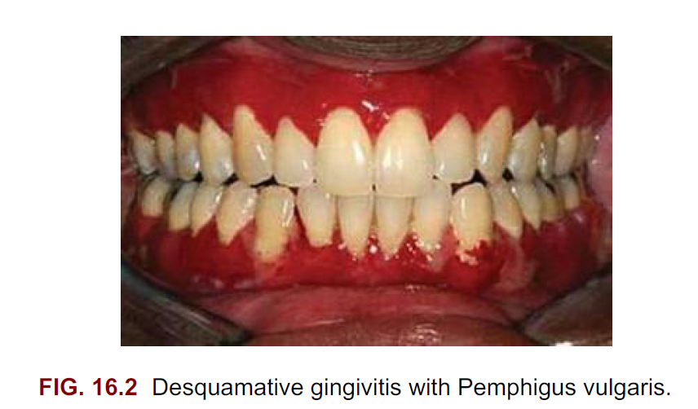

Slide 14
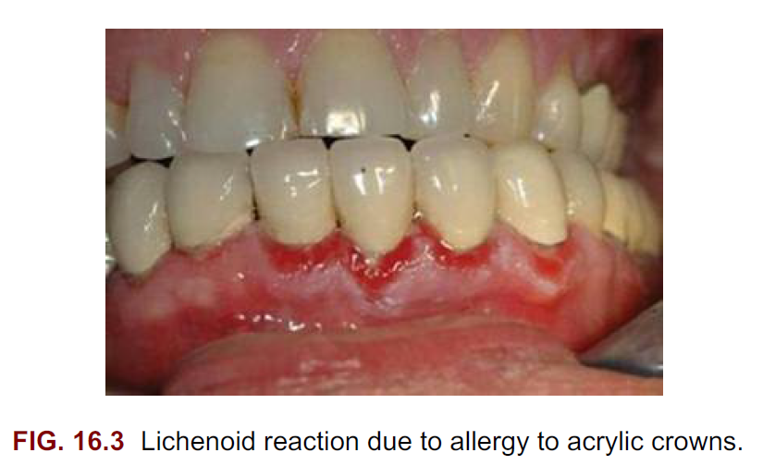

Slide 15
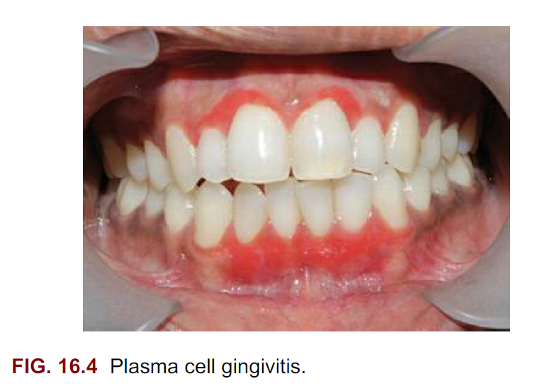

Slide 16
Clinical features
A “Macule” is a circumscribed flat area less than 1 cm of discoloration without elevation or depression of relative surface.
E.g., Erythema multiforme, hemangiomas, Koplik spots
A “Papule” is a circumscribed, elevated solid lesion less than 1 cm in diameter.
E.g., Papilloma

Slide 17
A “Patch” is a circumscribed flat area more than 1 cm.
E.g., Secondary syphilitic mucosal patch.
A “Vesicle” is a small superficial circumscribed elevated lesion less than 0.5 cm that contains serous fluid.
E.g., Herpetic gingivitis, Erythema multiforme
A “Bulla” is a bigger vesicle (>0.5 cm)

Slide 18
A “Nodule” is a palpable, solid lesion greater than 1 cm in diameter found in the skin
e.g., Xanthoma
A “Pustule” is an elevated, circumscribed lesion that contains pus.
E.g., Anthrax
An “Ulcer” is a break in the continuity of the epithelium due to molecular disintegration

Slide 19
A “Purpura” is a reddish to purple flat lesion caused by blood from vesicles leaking into submucosal tissue. Does not blanch when pressed.
Classified as petechiae or ecchymosis depending on the size.

Slide 20
Nikolsky’s sign refers to the ability to induce peeling of a bulla as a consequence of applying lateral pressure to the border of an intact bulla.
It is used to identify suprabasal or intraepithelial splits in the lesion.
It is found in pemphigus.

Slide 21
Auspitz’s sign is the appearance of punctate bleeding spots when a psoriasis lesion is scrapped off
Tzanck cells: a degenerated cell from the epithelium disconnected from adjacent cells caused by acantholysis seen in pemphigus.

Slide 22
Acantholysis is the loss of intercellular connection such as desmosomes resulting in loss of cohesion between kertinocytes.
It is present in pemphigus vulgaris but absent in bullous pemphigoid.

Slide 23
Clinical features
1.5 to 2.5 % of population
females being more affected than males.
It is most common in the third or fourth decade of life but can be seen in younger individuals.
Patients may be asymptomatic; when symptomatic their complaints range from burning sensation to severe pain.

Slide 24
Approximately 50% of the cases are confined to gingiva but other intra oral and dermatological involvement may be found.
Lesions such as pemphigus vulgaris have systemic impact which transcends the boundaries of the oral cavity and results in significant morbidity and even mortality

Slide 25
Glickman and Smulow have described three forms of Desquamative gingivitis viz.
mild,
moderate, and
severe.

Slide 26
Mild form
1. Diffuse erythema
2. Condition is usually painless
3. Some blanching may be seen
4. Patients may complain of intolerance to hot and spicy foods

Slide 27
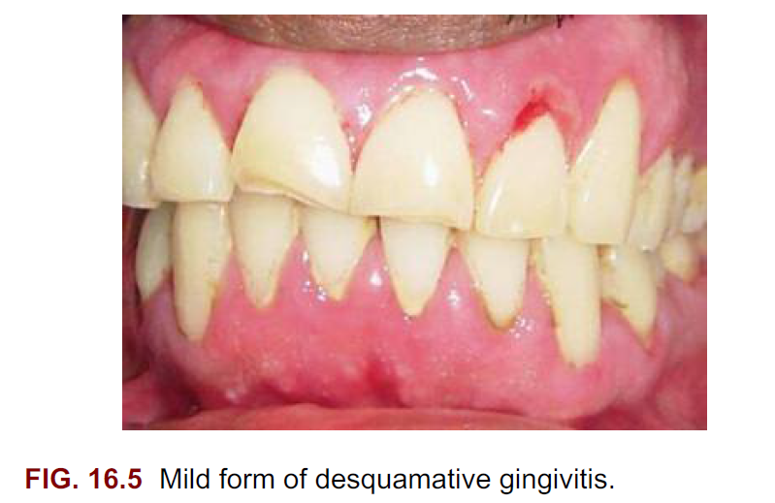

Slide 28
Moderate form
1. Patchy distribution of bright red and gray areas
2. Smooth, shiny, soft gingiva
3. Burning sensation, sensitivity to temperature
4. Inhalation of air may be painful
5. Massaging the gingiva results in peeling of the
epithelium with bleeding on brushing
6. Intolerance to spicy foods, citrus fruits and drinks
7. Brushing is highly discomforting

Slide 29
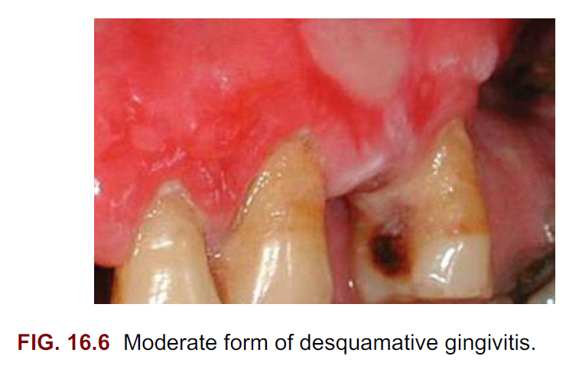

Slide 30
Severe form
1. Wide areas of the oral cavity involved
2. Surface epithelium appears shredded
3. Blowing of air causes a bubble in gingival
epithelium
4. Very painful
5. Constant dry, burning sensation

Slide 31
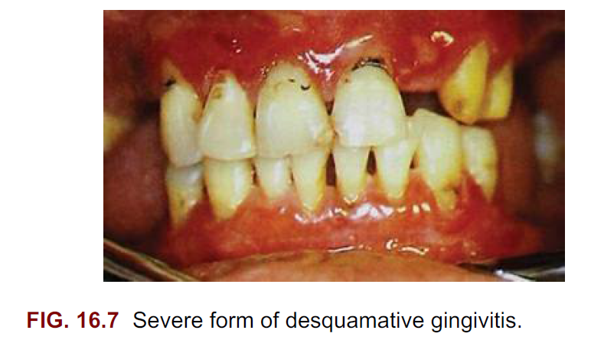

Slide 32
Management
1. A meticulous history
2. Careful clinical examination
3. Opinion from a dermatologist if necessary
4. Biopsy and other investigations
5. Local and systemic therapy

Slide 33
Clinical history
symptoms associated with this condition as well as its historical aspects (i.e., when the lesion started, whether it has worsened, if there is a habit that exacerbates the condition) previous therapy to alleviate the condition

Slide 34
Clinical examination
Recognition of the pattern of distribution of the lesions (i.e., focal or multifocal, with or without confinement to the gingival tissues)
With a pledget of wet cotton roll the lesions may be gently scrapped to see any peeling of the surface epithelium.

Slide 35
The handle of a mouth mirror or periodontal probe may gently be pressed on the lesion to observe any tissue blanching. Examination of the skin and eyes may reveal features leading to diagnosis

Slide 36
Biopsy
An incisional biopsy is the best alternativeto begin the microscopic and immunologic evaluation.
Selection of the biopsy site…..A perilesional incisional biopsy should avoid areas of ulceration, because necrosis and epithelial denudation severely hamper the diagnostic process.

Slide 37
Biopsy is done best after initial scaling and debridement so that plaque associated marginal gingivitis does not confuse the picture

Slide 38
After the tissue is excised from the oral cavity, the specimen can be bisected and then submitted for microscopic examination.
Buffered formalin (10%) should be used to fix the tissue for conventional hematoxylin-eosin (H&E) evaluation.
Michel’s buffer (ammonium sulfate buffer, pH 7.0) is used as transport solution for immunofluorescence assessment.

Slide 39
In general, an incisional biopsy of uninvolved (normal) mucosa will show the same immunofluorescent findings as the biopsy of the perilesional tissue.
However, there are notable exceptions, such as lichen planus and chronic cutaneous lupus erythematosus, in which only the lesional tissue will exhibit the corresponding immunologic markers.

Slide 40
Microscopic examination
Sections of approximately 5 μm of formalin-fixed, paraffin-embedded tissue stained with conventional H&E are obtained for light microscopy examination.

Slide 41
Immunofluorescence
For direct immunofluorescence, unfixed frozen sections are incubated with a variety of fluorescein-labeled, antihuman serum (i.e., anti-IgG, anti-IgA, anti-IgM, antifibrin, and anti-C3).

Slide 42
With indirect immunofluorescence, unfixed frozen sections of oral or esophageal mucosa from an animal such as a monkey are first incubated with the patient’s serum to allow for the attachment of any serum antibodies to the mucosal tissue.
The tissue is then incubated with fluorescein labeled antihuman serum.

Slide 43
Immunofluorescence tests are positive if a fluorescent signal is observed in the epithelium, its associated basement membrane, or the underlying connective tissue.

Slide 44
SUMMARY
Desquamative gingivitis is not a specific disease entity but a manifestation of several disorders. Approximately 75% of the cases have dermatologic genesis. Intense erythema and peeling of the surface epithelium of the surface epithelium involving marginal and attached gingiva are the main features. Symptoms vary from mild discomfort to severe burning sensation and pain. Lichen planus, mucous membrane pemphigoid and pemphigus are the most common conditions leading to desquamative gingivitis.

Slide 45
REFERENCE
Newman MG, Takei HH, Klokkevold PR, Carranza FA. Carranza’s clinical periodontology, 10th ed. Saunders Elsevier; 2007.
Lindhe J, Lang NP and Karring T. Clinical Periodontology and Implant Dentistry. 6th ed. Oxford (UK): Blackwell Publishing Ltd.; 2015.
Newman MG, Takei HH, Klokkevold PR, Carranza FA. Carranza’s clinical periodontology, 13th ed. Saunders Elsevier; 2018.

Slide 46
THANK YOU

